Slide 1
Applied Data Science Capstone Project Prediction of Car Accidents Severity

Slide 2
Outline

Slide 3
Problem Definition & Analytical Approach
How can we control car accidents in Seattle?
Historical data set available including accident severity information.
Classification model can be developed to predict severity level based on some features that can be controlled or manipulated by Seattle Department of Transport decision makers.

Slide 4
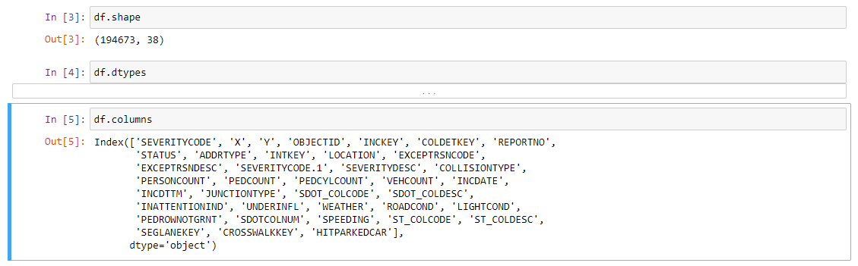
Data Set

Slide 5
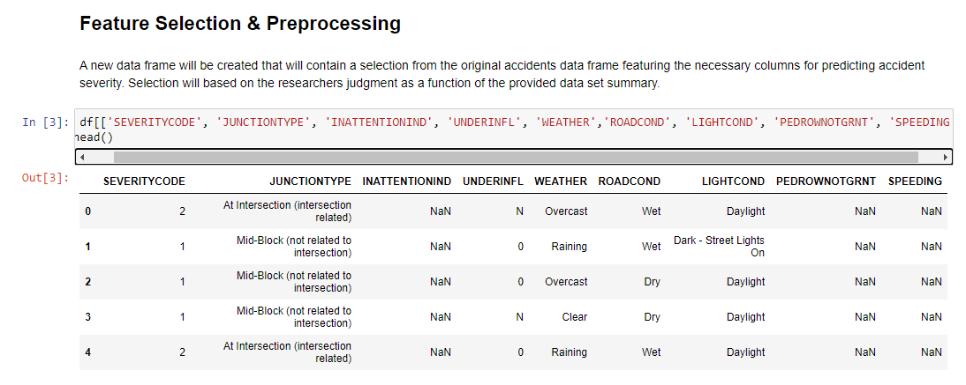
Feature Selection

Slide 6
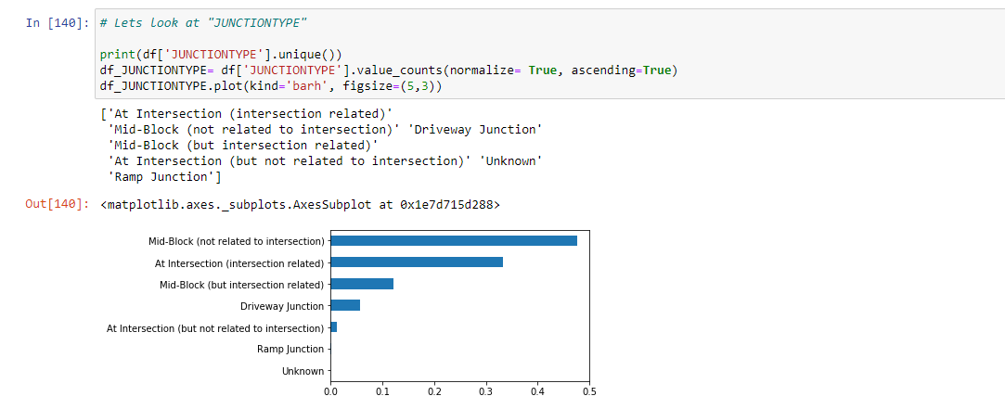
Data Exploration & Preprocessing

Slide 7
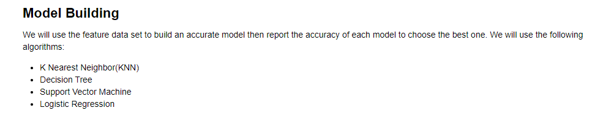
Modelling as a classification problem

Slide 8
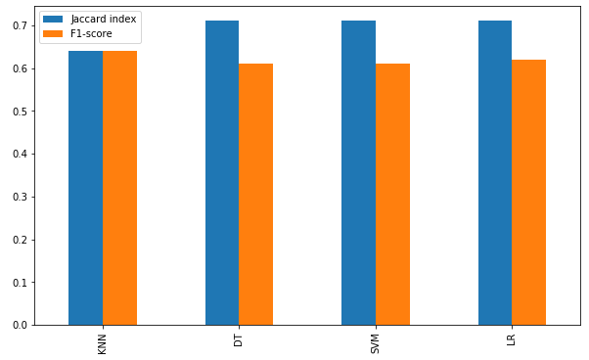
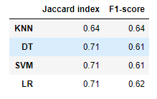
Model Accuracy

